Slide 1
STA/BST 222 Survival Analysis Lecture 16
Lihong Qi
Division of Biostatistics
Department of Public Health Sciences
School of Medicine
Nov 24, 2020

Slide 2
How to contact me
Email is best: lhqi@ucdavis.edu
Phone: 530-754-9234
Office hour: email for an appointment

Slide 3
How to contact TA
Xiner Zhou
Email: xezhou@ucdavis.edu
Office hours: 7:00pm – 8:00pm, Thursdays
Lab: 6:10-7:00 pm, Thursdays
For both Lab and OH, please use the zoom link with passcode: survival https://ucdstats.zoom.us/j/9681353237?pwd=ZzhLRHlhNG92bHFUaHkwM0Fib1pqQT09 Meeting ID: 968 135 3237

Slide 4
Focus
Semiparametric proportional hazards (PH) regression
Model diagnostics

Slide 5
Residuals for Survival Data
Cox-Snell residuals to check overall fit of the model
Martingale residuals to check nonlinearity ofa covariate
Deviance residuals to identify outliers
Score residuals to examine influential observations
Schoenfeld residuals to test PH assumption

Slide 6
Deviance Residuals
The previous residuals are all right skewed.
Deviance residuals try to symmetrize martingale residuals.
Definition
The deviance residual is a normalized transform of the martingale residual. These residuals are much more symmetrically distributed about zero.
Observations with large deviance residuals are poorly predicted by the model.

Slide 7
Deviance Residuals
Behave like residuals from ordinary linear regression
Should be symmetrically distributed around 0 and have standard deviation of 1.0.
Negative for observations with longer than expected observed survival times.
Plot deviance residuals against covariates to look for unusual patterns.

Slide 8
Check PH assumption

Slide 9
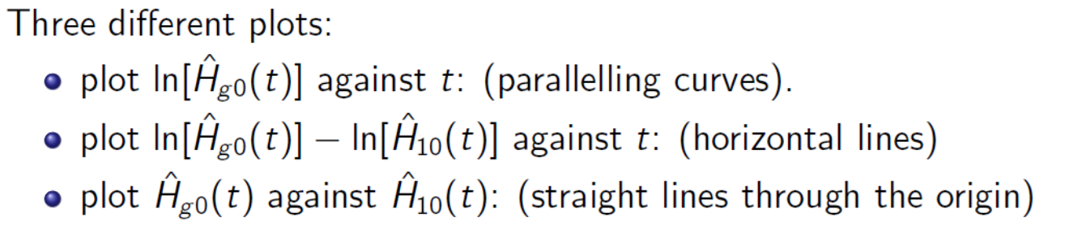
Review: plots

Slide 10
Approaches
Graphical
Goodness-of-fit (GOF)
Time-dependent variables

Slide 11

Graphical Approach
Log-log survival plot
Why –log[S(t)]?
0≤S(t)≤1 and -∞≤-log[-log[S(t)]]≤+∞
Difference between S(t|Z=z*) and S(t|Z=z’) should equal , a constant over time!
Two log-log survival plots (ie. log(H(t)) should be parallel.
$$−\log{[}−\log{[}S(t|Z)]]=\log{[}H_{0}(t)]+βZ$$
$$β(z^{∗}−z′)$$

Slide 12
Remarks: Log-log survival plot
How parallel is parallel?
Subjective decision
Conservative strategy: PH is OK unless strong evidence of non-parallelism
How to handle a continuous covariate?
Categorize the covariate (e.g. quartiles)
Small number of categorizes
Meaningful choice, e.g. BMI: <18.5 (underweight); 18.5-24.9 (normal); 25-29.9 (overweight); >29.9 (obesity)
Multiple covariates?
Data “thins out”
Difficult to identify variables responsible for non-parallelism

Slide 13
Observed vs. expected plots
Observed vs. expected plots
Graphical analog of goodness of fit (GOF) test
Two strategies for observed plots
One-at-a-time: use KM curves to obtain observed plots for each group, e.g. placebo and treatment.
Adjusting for other variables for each of the above group separately (e.g. Cox PH model).
Expected plots
Fit a Cox PH model with the predictor of interest, e.g. treatment indicator.
Estimate survival curve for each of the treatment group using the fitted PH model.

Slide 14
Observed vs. expected plots (cont’d)
Expected plots for a continuous variable
Categorize the variable and then create dummy variables
Fit a Cox PH model using the dummy variables as the covariates and find predicted survival curve for each category.
Or fit a Cox PH model using the continuous variable as the covariate.
Then use the mean value for each of the above categories to estimate survival curve.

Slide 15
Observed vs. expected plots (cont’d)
If observed and expected plots are
Close: complies with PH assumption
Discrepant: PH assumption violated.
How close is close?
PH not satisfied only when plots are strongly discrepant.

Slide 16
Example: Auto/Allo Bone Marrow Transplant, KM 1.9
Expected consistently lower, except at the tail➔ PH not met!

Slide 17
Goodness of Fit (GOF) Approach
Statistical test appealing
Provides p-value
More objective decision than when using graphical approach
How to construct test?
Using Schoenfeld residuals

Slide 18
Schoenfeld residuals
Schoenfeld (1982) proposed the first set of residuals for use with Cox regression packages
Schoenfeld D. Residuals for the proportional hazards regresssion model. Biometrika, 1982, 69(1):239-241.
Instead of a single residual for each individual, there is a separate residual for each individual for each covariate
Note: Schoenfeld residuals are not defined for censored individuals.

Slide 19
Schoenfeld residuals
Definition of Schoenfeld residuals
For subject i who had event at time ti and with covariate Z=z, the residual is z - weighted average of Z for the subjects still at risk at ti.
Weights are the subjects’ hazard.
Underlying idea of test
If PH holds, then Schoenfeld residuals are uncorrelated with time.

Slide 20
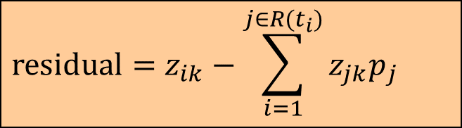
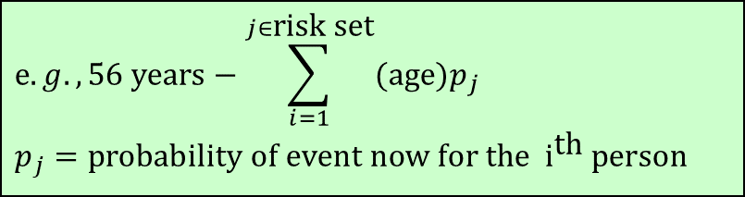
Schoenfeld residuals
The Schoenfeld residual: observed covariate – expected covariate at each failure time
Yields residuals for each failure and for each covariate.
Expected value of the covariate at time t_{i} = weighted-average of the covariate, weighted by the likelihood of failure for each individual in the risk set at t_{i}.
$$\text{residual}=z_{ik}−\sum_{i=1}^{j∈R(t_{i})}{z_{jk}p_{j}}$$
$$e.g.,\text{56 }\text{years}−\sum_{i=1}^{j∈\text{risk} \text{set}}{(\text{age})p_{j}} \\ p_{j}=\text{probability} \text{of} \text{event} \text{now} \text{for} \text{the} {\text{i}}^{\text{th}} \text{person}$$

Slide 21
Schoenfeld residuals
Since the Schoenfeld residuals are, in principle, independent of time, a plot that shows a non-random pattern against time is evidence of violation of the PH assumption.
Plot Schoenfeld residuals against time to evaluate PH assumption
Regress Schoenfeld residuals against time to test for independence between residuals and time.

Slide 22
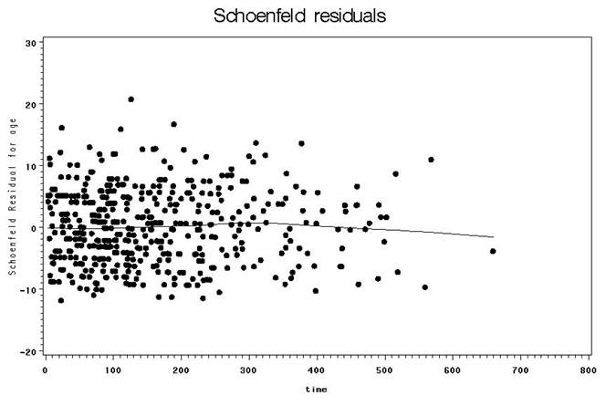
Example: no pattern with time

Slide 23
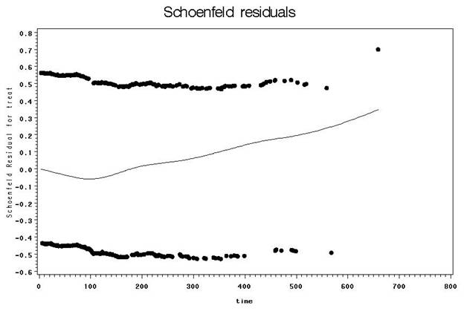
Example: violation of PH

Slide 24
Schoenfeld residuals
Steps for test implementation
Obtain Schoenfeld residuals for each predictor by fitting a PH model
Rank failure time by creating a variable that ranks the order of failures, e.g. the subject who had event first gets a value of 1, etc.
Test correlation of residuals to ranked failure time, e.g.
H0 rejected ➔ PH assumption violated
Recommend that you look at both the graph of the regression and the tests of non-zero slopes.

Slide 25
Example: Auto/Allo Bone Marrow Transplant, KM 1.9
Covariate of interest: type of transplant
Fit a Cox PH model with type as the only covariate
Calculate Schoenfeld residuals
Rank event times only
Correlation between the residuals and ranked time is -0.4 with a p-value of 0.004<0.05 ➔ PH not met!

Slide 26
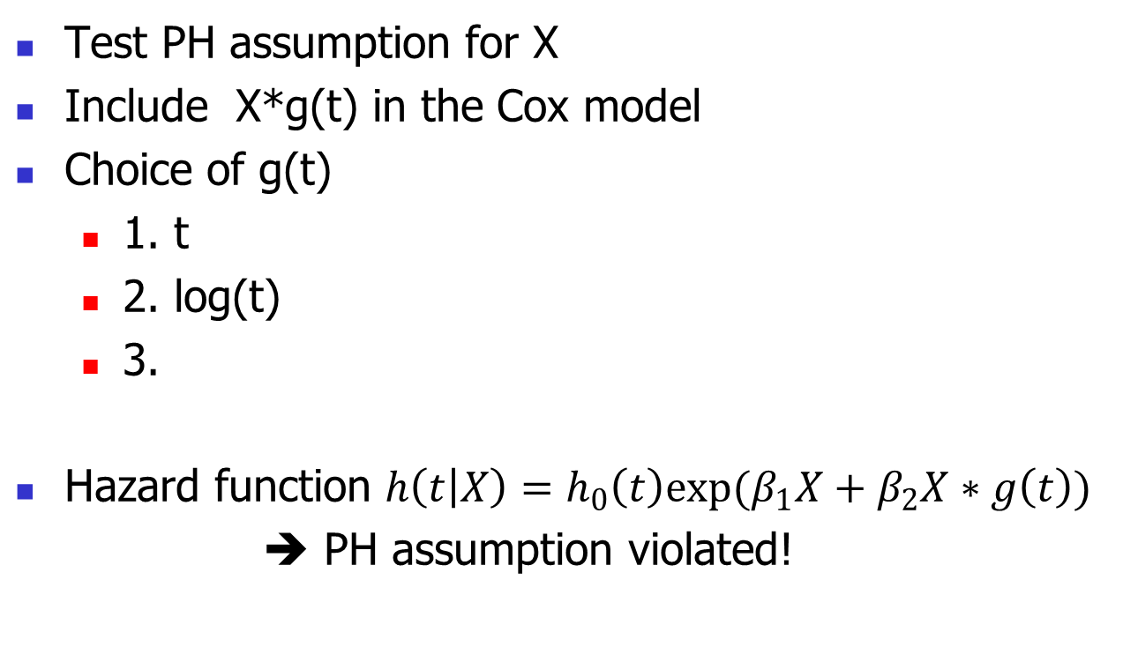
Time-dependent Variable Approach
Test PH assumption for X
Include X*g(t) in the Cox model
Choice of g(t)
1. t
2. log(t)
3.
Hazard function $h\left(t | X\right)=h_{0}\left(t\right)exp(β_{1}X+β_{2}X∗g\left(t\right))$
➔ PH assumption violated!

Slide 27
Example: Auto/Allo Bone Marrow Transplant, KM 1.9
Create a time-dependent variable
e.g. Allo*Time
Fit a Cox PH model with Allo and Allo*time as covariates.
Results
P-value for Allo*time <0.0001➔PH not met!
Allo effect is affected by time based on the Cox PH model.

Slide 28
Summary of ways to evaluate PH assumption
Examine log(-log(S(t)) plots
PH assumption is supported by parallel lines and refuted by lines that cross or nearly cross
Must use categorical predictors or categories of a continuous predictor
Include interaction with time in the model
PH assumption is supported by non-significant interaction coefficient and refuted by significant interaction coefficient
Retaining the interaction term in the model corrects for the violation of PH
Don’t complicate your model in this way unless it’s absolutely necessary!

Slide 29
Summary of the many ways to evaluate PH assumption…
Plot Schoenfeld residuals
PH assumption is supported by a random pattern with time and refuted by a non-random pattern
Regress Schoenfeld residuals against time to test for independence between residuals and time.
PH assumption is supported by a non-significant relationship between residuals and time, and refuted by a significant relationship

Slide 30
Cox model with interaction term

Slide 31
Interpretation of an interaction
Z1 = sex, 1 for male and 0 for female
Z2 = age in years
h(t|Z1, Z2) = h_0(t)exp(beta1*Z1 + beta2*Z2, beta3*Z1*Z2)
Interpretation of beta
exp(beta1), Z1=1, Z2=0: Relative risk (or hazard ratio) comparing male to male among those with age (= Z2) = 0.
exp(beta1+z2*beta3), Z1=1, Z2=z2: Relative risk comparing male to female among those with age (= Z2) = z2. Need a specify a value for age when obtaining HR for an interaction term

Slide 32
Including interactions
Based on science and prior knowledge
Without prior knowledge, can include interaction terms of interest or all possible interaction terms if sample size allows
When interaction term is significant statistically, can conduct separate analysis at each stratum, subgroup analysis.

Slide 33
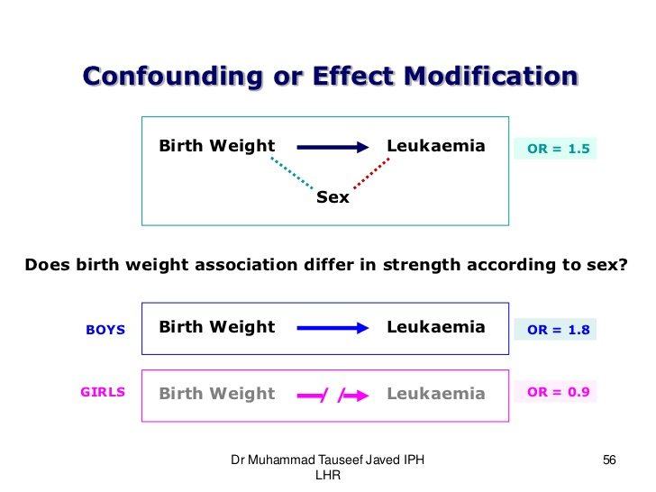

Slide 34
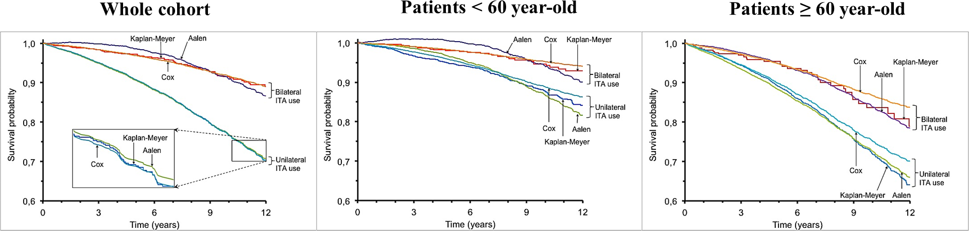
https://www.semanticscholar.org/paper/Quantification-of-Treatment-Effect-Modification-on-Girerd-Rabilloud/e987723b94eda58148ca0f44bf6a9bf630b3f663

Slide 35
Homework 4
Reading: KM 8.6, 11.1-11.6
Others: to be posted

